Slide 1
Introduction to Machine Learning and Data Mining (Học máy và Khai phá dữ liệu)
Khoat Than
School of Information and Communication Technology
Hanoi University of Science and Technology

Slide 2
Contents
Introduction to Machine Learning & Data Mining
Unsupervised learning
Supervised learning
Probabilistic modeling
Data mining
Association rule
Apriori
Practical advice

Slide 3
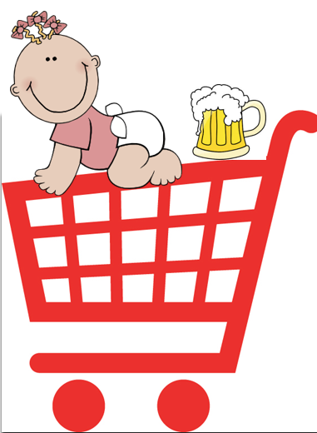
Association rule discovery
Supermarket shelf management: Market-basket model
Goal: identify items that are bought together by sufficiently many customers. (tìm ra những sản phẩm mà hay được mua cùng nhau)
Approach: process the sales data collected with barcode scanners to find dependencies among items.
A classical rule:
If someone buys diaper and milk, then he/she is likely to buy beer.
Do not surprised if you find beer packs next to diapers !
(Adapted from a lecture by Jure Leskovec)

Slide 4
The Market-Basket Model
A large set of items
E.g., things sold in a supermarket
A large set of baskets
Each basket is a small subset of items
e.g., the things one customer buys on one day
Association: a general many-to-many mapping between two kinds of things (một ánh xạ nhiều-nhiều giữa hai loại đối tượng)
But we ask about connections among “items”, not “baskets”
TID | Items
1 | Bread, Coke, Milk
2 | Beer, Bread
3 | Beer, Coke, Diaper, Milk
4 | Beer, Bread, Diaper, Milk
5 | Coke, Diaper, Milk

Slide 5
Association rules: approach
Given a set of baskets
Want to discover association rules (tìm tập các luật kết hợp)
People who bought {x,y,z} tend to buy {v,w}
2 step approach:
Find frequent itemsets (tìm tập thường xuyên)
Generate association rules (sinh các luật kết hợp)
TID | Items
1 | Bread, Coke, Milk
2 | Beer, Bread
3 | Beer, Coke, Diaper, Milk
4 | Beer, Bread, Diaper, Milk
5 | Coke, Diaper, Milk
Rules discovered:
{Milk} → {Coke}
{Diaper, Milk} → {Beer}

Slide 6
Applications
Items = products; baskets = sets of products someone bought in one trip to the store
Real market baskets: stores might keep TBs of data about what customers buy together
Tells how typical customers navigate stores, lets them position tempting items
Suggests tie-in “tricks”, e.g., run sale on diapers and raise the price of beer
Need the rule to occur frequently
Amazon’s people who bought X also bought Y.

Slide 7
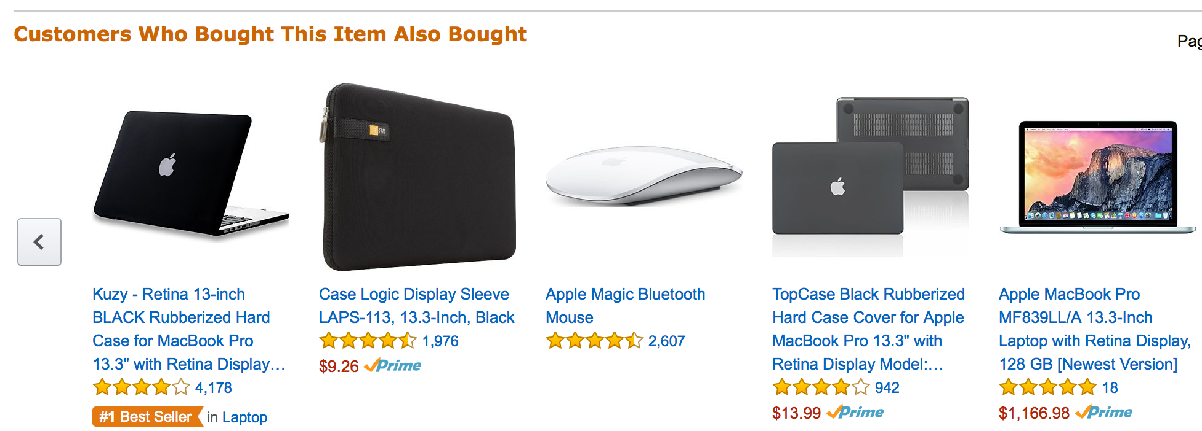
Applications: amazon

Slide 8
Frequent itemsets
Question: find sets of items that appear together “frequently” in baskets
Support for itemset I: number of baskets containing all items in I.
Often expressed as a fraction of the total number of baskets
Given a support threshold s, then sets of items that appear in at least s baskets are called frequent itemsets. (tập thường xuyên là tập những sản phẩm mà chúng xuất hiện cùng nhau trong ít nhất s giỏ hàng)
TID | Items
1 | Bread, Coke, Milk
2 | Beer, Bread
3 | Beer, Coke, Diaper, Milk
4 | Beer, Bread, Diaper, Milk
5 | Coke, Diaper, Milk
Support of {Beer, Bread} = 2

Slide 9
Frequent itemsets: example
Items = {Milk, Coke, Pepsi, Beer, Juice}
Support threshold = 3 baskets
B1 = {m, c, b} B2 = {m, p, j}
B3 = {m, b} B4 = {c, j}
B5 = {m, p, b} B6 = {m, c, b, j}
B7 = {c, b, j} B8 = {b, c}
Frequent itemsets: {m}, {c}, {b}, {j}, {m, b}, {b, c}, {c, j}

Slide 10
Association rules
Association rules: If-then rules about the content of baskets
{i₁, i₂, …, i_{k}} → j means: “if a basket contains all of {i₁, i₂, …, i_{k}}, then it is likely to contain j”
(nếu một giỏ hàng mà chứa {i₁, i₂, …, i_{k}} thì nó cũng có thể chứa j)
In practice there are many rules, we want to find significant or interesting rules.
Confidence of this association rule is the probability of j given I = {i₁, i₂, …, i_{k}}
Confidence của luật I → j là xác suất của j với điều kiện I

Slide 11
Interesting association rules
Not all high-confidence rules are interesting
The rule X → milk may have high confidence for many itemsets X, because milk is purchased very often (independent of X) and the confidence will be high
Interest of an association rule I →j: difference between its confidence and the fraction of baskets that contain j.
Interest(I →j) = conf(I →j) – Pr(j)
Interesting rules are those with high positive or negative interest values (usually above 0.5)
Why?

Slide 12
Confidence and Interest: example
B1 = {m, c, b} B2 = {m, p, j}
B3 = {m, b} B4 = {c, j}
B5 = {m, p, b} B6 = {m, c, b, j}
B7 = {c, b, j} B8 = {b, c}
Association rule: {m,b} →c
Confidence = 2/4 = 0.5
Interest = |0.5 - 5/8| = 1/8 (item c appears in 5/8 of the baskets)
Rule is not very interesting

Slide 13
Finding association rules
Problem: find all association rules with support ≥ s and confidence ≥ c.
Note: support of an association rule is the support of the set of items on the left side.
Hard part: finding the frequent itemsets
If {i₁, i₂, …, i_{k}} → j has high support and confidence, then both {i₁, i₂, …, i_{k}} and {i₁, i₂, …, i_{k}, j} will be frequent.

Slide 14
Mining association rules
Step 1: find all frequent itemsets I
Step 2: rule generation
For every subset A of I, generate rule A→ I \ A
Since I is frequent, A is also frequent
Variant 1: Single pass to compute the rule confidence confidence(A,B→C,D) = support(A,B,C,D) / support(A,B)
Variant 2:
Observation: If A,B,C→D is below confidence, so is A,B→C,D
Can generate “bigger” rules from smaller ones!
Output the rules above the confidence threshold

Slide 15
Example
B1 = {m, c, b} B2 = {m, p, j}
B3 = {m, b} B4 = {c, j}
B5 = {m, p, b, c} B6 = {m, c, b, j}
B7 = {c, b, j} B8 = {b, c}
Support threshold s = 3, confidence c = 0.75
Frequent itemsets: {b,m}, {b,c}, {c,m}, {c,j}, {m,c,b}
Generate rules:
b→m: c=4/6 m→b: c=4/5
b→c: c=5/6 ...
b,c→m: c=3/5 b,m→c: c=3/4
b→c,m: c=3/6

Slide 16
Compacting the output
To reduce the number of rules, we can post-process them and only output:
Maximal frequent itemsets: No immediate superset is frequent (give more pruning)
Closed itemsets: No immediate superset has the same count (> 0)
Stores not only frequent information, but exact counts

Slide 17
Example: maximal/closed

Slide 18
Finding Frequent Itemsets

Slide 19
Itemsets: computation model
Typically, data is kept in flat files rather than in a database system:
Stored on disk
Stored basket-by-basket
Baskets are small but we have many baskets and many items
Expand baskets into pairs, triples, etc. as you read baskets
Use k nested loops to generate all sets of size k
Note: We want to find frequent itemsets. To find them, we have to count them. To count them, we have to generate them.
Items are positive integers, and boundaries between baskets are -1.

Slide 20
Computational model
The true cost of mining disk-resident data is usually the number of disk I/Os
In practice, association-rule algorithms read the data in passes – all baskets read in turn
We measure the cost by the number of passes an algorithm makes over the data

Slide 21
Main-memory bottleneck
For many frequent-itemset algorithms, main-memory is the critical resource
As we read baskets, we need to count something, e.g., occurrences of pairs of items
The number of different things we can count is limited by main memory
Swapping counts in/out is a disaster (why?)

Slide 22
Finding Frequent Pairs
The hardest problem often turns out to be finding the frequent pairs of items {i₁, i₂}
Why?
Frequent pairs are common, frequent triples are rare.
Probability of being frequent drops exponentially with size, number of sets grows more slowly with size.
Let’s first concentrate on pairs, then extend to larger sets
The approach:
We always need to generate all the itemsets.
But we would only like to count (keep track of) those itemsets that in the end turn out to be frequent.

Slide 23
Naïve algorithm
Naïve approach to finding frequent pairs
Read file once, counting in main memory the occurrences of each pair:
If a basket has n items, then we need to generate n(n-1)/2 pairs.
Fail if (#items)² exceeds main memory
In practice, #items can be
100K (Wal-Mart) or 10B (Web pages)
Suppose 10⁵ items, counts are 4-byte integers
Number of pairs of items: 10⁵(10⁵-1)/2 = 5*10⁹
Therefore, 2*10¹⁰ (20 gigabytes) of memory needed

Slide 24
Counting pairs in memory
Approach 1: count all pairs using a matrix
Approach 2: keep a table of triples {i, j, c} = “the number of pairs of items {i,j} is c”
If integers and item ids are 4 bytes, we need approximately 12 bytes for pairs with count > 0.
Plus some additional overhead for the hashtable.
Note:
Approach 1 only requires 4 bytes per pair
Approach 2 uses 12 bytes per pairs (but only for pairs with count > 0)

Slide 25
Comparing the two approaches

Slide 26
Comparing the two approaches
Approach 1: triangular matrix
n = total number of items
Count pair of items {i,j} only if i < j
Keep pair counts in lexicographic order: {1,2}, {1,3},..., {1,n}, {2,3}, {2,4},...,{2,n}, {3,4},...
Pair {i,j} is at position (i –1)(n– i/2) + j –1
Total number of pairs n(n –1)/2; total bytes= 2n²
Triangular Matrix requires 4 bytes per pair
Approach 2 uses 12 bytes per counting pair (but only for pairs with count > 0)
Beats Approach 1 if less than 1/3 of possible pairs actually occur.

Slide 27
Comparing the two approaches
Approach 1: triangular matrix
n = total number of items
Count pair of items {i,j} only if i < j
Keep pair counts in lexicographic order: {1,2}, {1,3},..., {1,n}, {2,3}, {2,4},...,{2,n}, {3,4},...
Pair {i,j} is at position (i –1)(n– i/2) + j –1
Total number of pairs n(n –1)/2; total bytes= 2n²
Triangular Matrix requires 4 bytes per pair
Approach 2 uses 12 bytes per counting pair (but only for pairs with count > 0)
Beats Approach 1 if less than 1/3 of possible pairs actually occur.
Problem is
the pairs do not fit into memory
if we have too many items.
Can we do better?

Slide 28
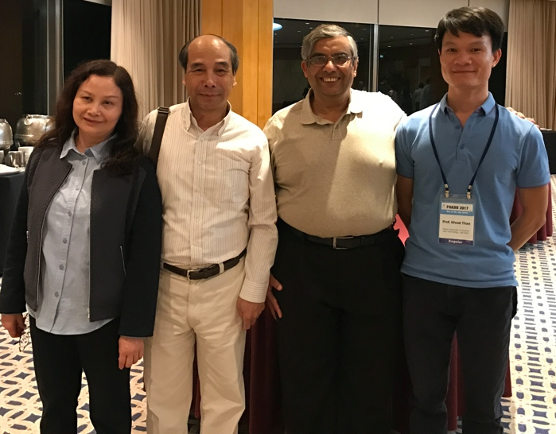
A-Priori algorithm (1)
A two-pass approach called A-Priori (by Agrawal and Srikant, 1994) limits the need for main memory
Key idea: monotonicity
If a set I of items appears at least s times, so does every subset J of I.
Contrapositive for pairs: If item i does not appear in s baskets, then no pair including i can appear in s baskets
So, how does A-Priori find frequent pairs?

Slide 29
A-Priori algorithm (2)
Pass 1: read baskets and count in main memory the occurrences of each individual item.
Requires only memory proportional to #items
Items that appear at least s times are the frequent items
Pass 2: Read baskets again and count in main memory only those pairs where both elements are frequent (from Pass 1)
Requires memory proportional to square of frequent items only (for counts)
Plus a list of the frequent items (so you know what must be counted)

Slide 30
Main-Memory: picture of A-Priori

Slide 31
Details of A-Priori
You can use the triangular matrix method with n = number of frequent items
May save space compared with storing triples
Trick: re-number frequent items 1,2,... and keep a table relating new numbers to original item numbers

Slide 32
Frequent triples, …
For each k, we construct two sets of k-tuples (sets of size k):
C_{k} = candidate k-tuples = those that might be frequent sets (support ≥ s) based on information from the pass for k–1
L_{k} = the set of truly frequent k-tuples

Slide 33
A-Priori: example
Hypothetical steps of the A-Priori algorithm
Generate C₁ ={{b} {c} {j} {m} {n} {p}}
Count the support of itemsets in C₁
Prune non-frequent to get L₁ = { b, c, j, m }
Generate C₂ = { {b,c} {b,j} {b,m} {c,j} {c,m} {j,m} }
Count the support of itemsets in C₂
Prune non-frequent to get L₂ = { {b,m} {b,c} {c,m} {c,j} }
Generate C₃ = { {b,c,m} {b,c,j} {b,m,j} {c,m,j} }
Count the support of itemsets in C₃
Prune non-frequent to get L₃ = { {b,c,m} }

Slide 34
A-Priori for All frequent itemsets
One pass for each k (itemset size)
Needs memory to count each candidate k–tuple
For typical market-basket data and reasonable support (e.g., 1%), k = 2 requires the most memory
Many possible extensions:
Association rules with intervals:
For example: Men over 65 have 2 cars
Association rules when items are in a taxonomy
Bread, Butter → FruitJam
BakedGoods, MilkProduct → PreservedGoods
Lower the support s as itemset gets bigger

